Slide 1
Web Based Recruitment Process System
Submitted to :
Mrs Neha Janu
Reader,
IT Department
Submitted By:
Abhinav Jain(12ESKIT002)
Akanksha Bhambhani (12ESKIT006)
Akshay Mehta(12ESKIT011)
Avinash Chaurasiya(12ESKIT020)

Slide 2
Overview
Introduction
Purpose and Scope
Software Specification
Implementation
Screenshots
Conclusion

Slide 3
Introduction
It is a web-based application, which helps end user to find a job with searching criteria like type of company and location.
It also helpful to “post job” and “search candidate” based on jobseeker profile. Jobseekers can download sample resume.
Job provider can post jobs ,edit and delete their job postings and can view applied candidates for their listing.
Admin manages the portal resolve any problem.
One can post his/her details on this portal with all relative information.

Slide 4
Purpose:-
This system tends to replace the existing manual system for the recruitment process which is a time consuming, less interactive and highly expensive.
The main features of this system is to provide an interface between job providers and jobseekers, so that they can find suitable candidates and companies.
Scope:-
The Online job Portal System that is to be provides the members with jobs information, online applying for jobs and many other facilities.
The job seeker can apply for the preferred jobs and search job as per his/her requirement.

Slide 5
Technology Used
Front End
Back End
HTML
CSS
JAVASCRIPT
JAVA EE
SQL
JAVA SE

Slide 6
About Java EE
Java 2 Enterprise Edition(J2EE) is a platform independent environment from Sun Microsystems for building and deploying Web-based applications.
JavaServer Pages (JSP) is a technology that helps developers create dynamically generated web pages based on HTML, XML, or other document types.
Jsp life cycle has 3 methods:
jspinit()
jspService()
jspDestroy()

Slide 7
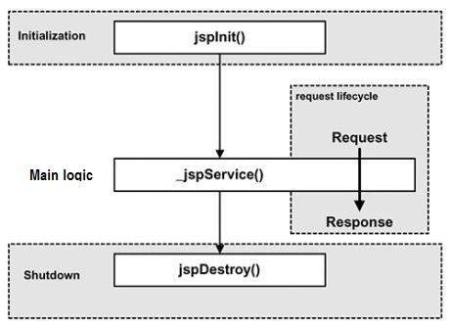
Continued..
Jsp consists of 3 elements:
Directives
Scripting Elements
Action elements

Slide 8
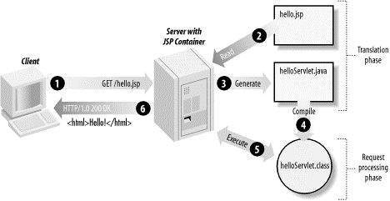
Working of Jsp:

Slide 9
System Requirement Specification
Hardware Requirement
Processor: Any Pentium IV or compatible
RAM: Minimum 512 MB
Software Requirement
Back End :Mysql 5.0, Apache Tomcat 8.0,MyECLIPSE BLUE, Dreamweaver
Operating System: Windows XP, Windows 7
Browser: Mozilla Firefox, Chrome, Internet Explore

Slide 10
Implementation
Job Provider: This module contains functionalities of job provider. Employers can post job and update them when necessary.
Job Seeker: This module provide functionality for job seekers. Applicants can post their academic details and resumes. they can browse through various companies and can apply for any.
Admin Panel: This module provide administrator related functionalities. Admin manages entire application and maintains profile of users.

Slide 11
Screenshots

Slide 12
Conclusion
The wider areas of job searching facilitate the quick and easy access to opportunities. The increasing job opportunities and changing scenario of the business environment today has made more people to search for better career and employers to search for better potential.
This situation has prompted many to move to job portals to look for the ways that has been widely accepted and fully useful in job searching. In this sense the job portals assumes greater importance and we could develop such an efficient system which is used by lot many job hunters and employers.

Slide 13
Thank You

